Slide 1
Best Practices
Be sure and capture best practices that you learned from other sites and will take back to your country!

Slide 2
PITFALLS If you fall into a pit, I hope you learned something
Lessons
From the Pit

Slide 3
Today’s Topics – 5 Top Pitfalls
5 Pitfalls to Avoid
What to do differently next time
LEARN FROM
Process Mapping → Not connecting the process map to the project
Metric Selection - Not selecting the appropriate metric for the aim
Voice of the Customer – Not connected to the problem or the intervention
PDSAs – Only One and Done
Outcome Focus – Forgetting the big picture

Slide 4
PITFALL #1 Process Mapping
Process Mapping
Pitfalls
Not connecting the process map to the project

Slide 5
Pitfall

Slide 6
Story: Patient B ”Falls through the Cracks”
VL Ordered
VL Result recorded at Clinic Lab
Appointment Scheduled/ Missed
EC Calls to Reschedule Appointment
Appointment / Counseling
Second Counseling Appointment
Next Appointment/ 2nd VL?
2016
25 MAY
9 JUN
3 MAR
10 MAR
3 JUN
7 JUL
29 SEPT
10 MAR
9 JUN
VL = 61, 800
ID as High Viral Load
3 Months to Identify HVL

Slide 7
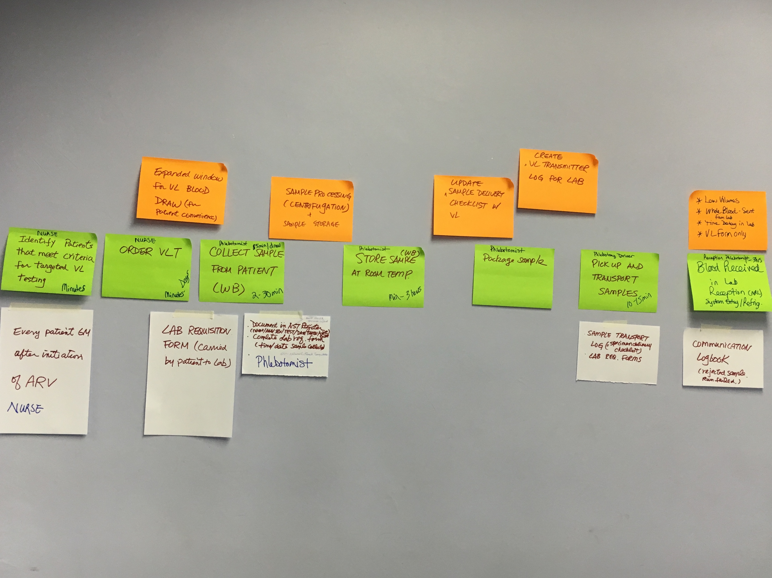
Process Mapping in Classroom

Slide 8
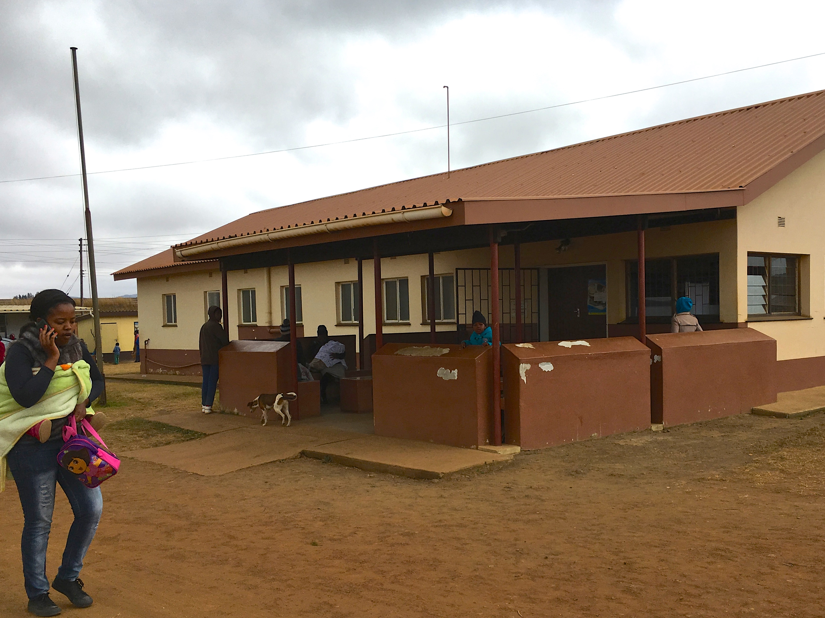
Go & See - Trace/Validate Process at Site

Slide 9
Process: Reported Current State
Results to Phlebotomist
Record in Lab Specimen Log
Results to ART Nurse
Review
Results to Expert Client
Call to make appointment
Expert Client Checks Appt. Register
F/U Appointment

Slide 10
Where are the printed laboratory results?
NOT in the patient’s chart
YES, results recorded in the lab register

Slide 11
Go & See - Trace/Validate Process at Site
8 METERS
RESULTS LOST

Slide 12
Where are the printed laboratory results?
Tracing the patient care
Unfiled, on the expert client's desk (last 3 months)

Slide 13
The ‘Ah Ha’ Moment

Slide 14
Process Step | What Happens? | Who is responsible? | Duration | Forms/logs | Opportunity for Improvement
14. Receive results and enter in NST logbook; sort result printouts into high vs low VL piles |  | Phlebotomist | 0.5 hour | NST logbook; test result reports | Direct communication of high VL results to clinic and patients (SMS); make high VL results visible (e.g., highlight)
15. Deliver results to ART nurse |  | Phlebotomist | 0.5 day |  | In-box on wall to receive high VL reports
16. Review results and deliver to Expert Client for follow-up action |  | ART nurse | 0.5 day |  | Have one dedicated nurse to manage care of all patients with high VL results; in-box on wall to receive high VL reports
17. Call patients with high VL results and schedule appointment for clinic visit | To coincide doctor’s visit | Nurse/expert client | 1-4 days | Call log and appointment book | How to identify all high VL patients
18. Monitor call log, appointment book, and chronic patient files |  | Expert client |  |  | Create a diary to ensure all follow-ups are done
Filing VL Results
Missing process step
Missing in EC job description

Slide 15
Knowledge Burst

Slide 16
"The first step in any organization is to draw a flow diagram (process map) to show how each component depends on others. Then everyone may understand what their job is. If people do not see the process, they cannot improve it."
W Edwards Deming (1900-1993)

Slide 17
"Draw a flowchart (process map) for whatever you are doing. Until you do, you do not fully understand what you are doing. You just have a job.”
W Edwards Deming (1900-1993)

Slide 18
Process Mapping IHI Video

Slide 19
The LARC Quality Improvement Collaborative: Smart Start 2-Day On-Site Session
Process Mapping & Beyond
LARC

Slide 20
2 Days
To set your project up for SUCCESS
Session Outcomes:
An understanding of your current state via process mapping
A complete project outline – with aims and measures – to provide clear direction for the project!

Slide 21
Smart Start – Two Days On-Site
Day #1 | Day #2
Orientation Process Mapping Current State | Project Outline Completed
Process Mapping @ Site - Go and See | Action Plan

Slide 22
Project Kickoff – Day #1
Day #1
Overview “Start with Why” Review Viral Load Cascade Review Process Mapping
Process Mapping Current State
Process Mapping @ Site - Go and See Chart Review

Slide 23
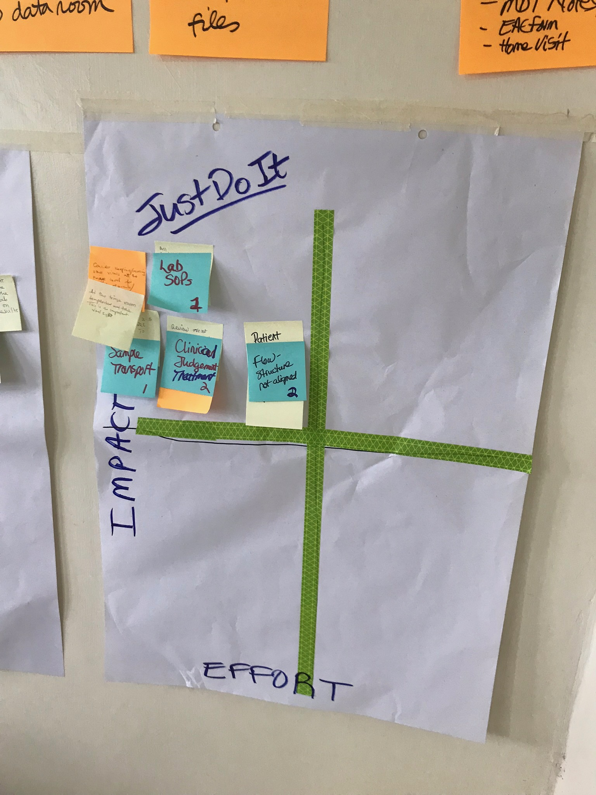
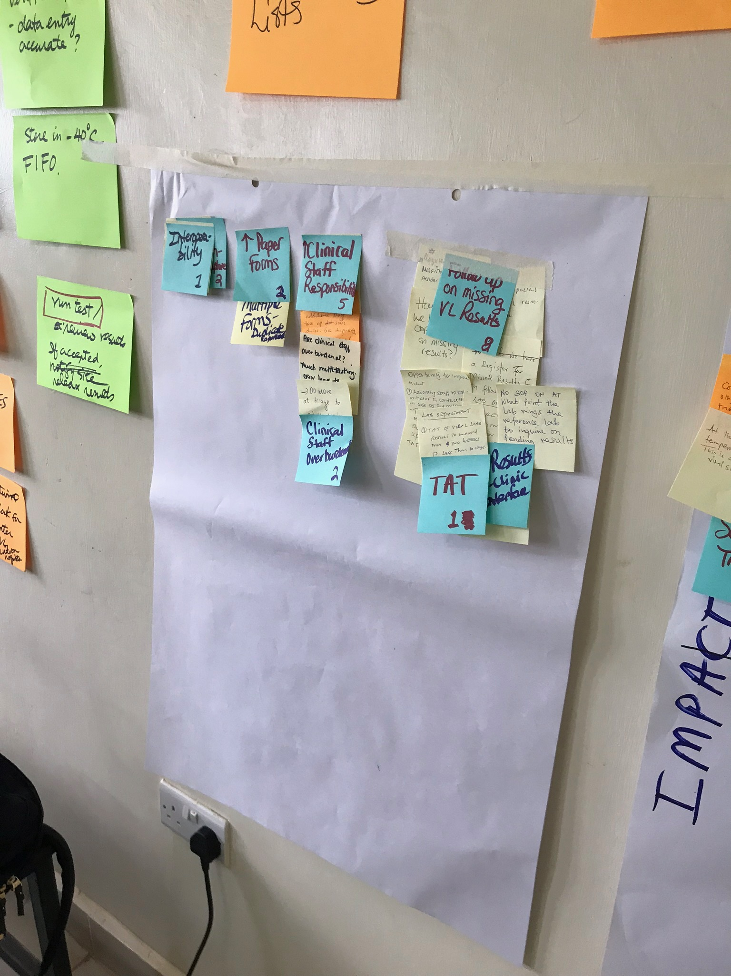
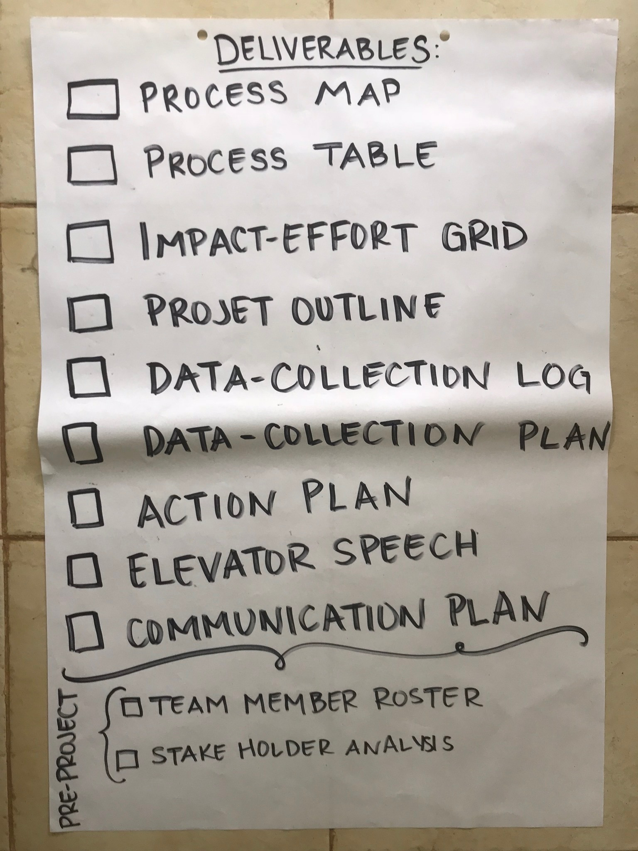
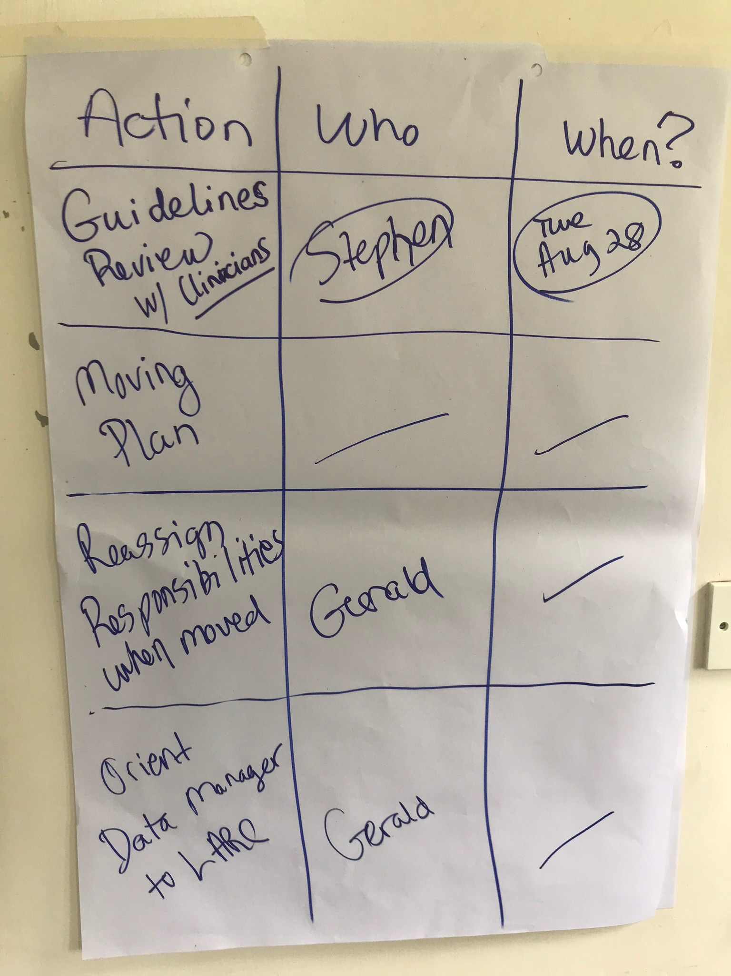
Project Kickoff – Day #2
Day #2
Summarize & Prioritize Opportunities for Improvement Ask 3 Questions Aim Statement Metric Selection with Data Collection Tool & Plan Elevator Speech
Action Plan Team Roles Set Meeting & Site Visit Dates

Slide 24
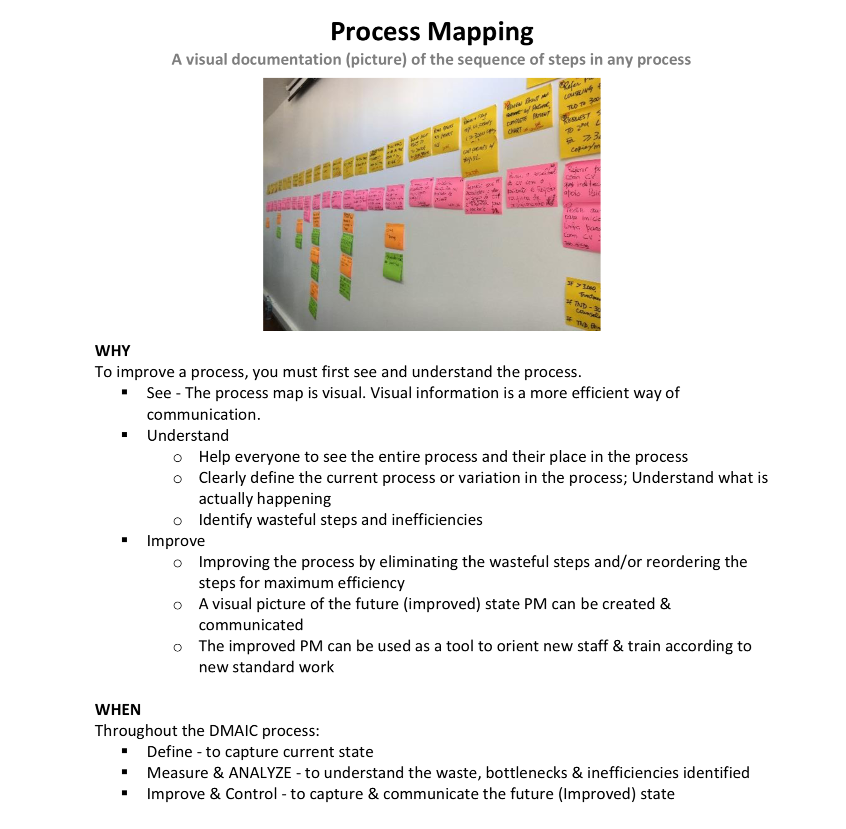
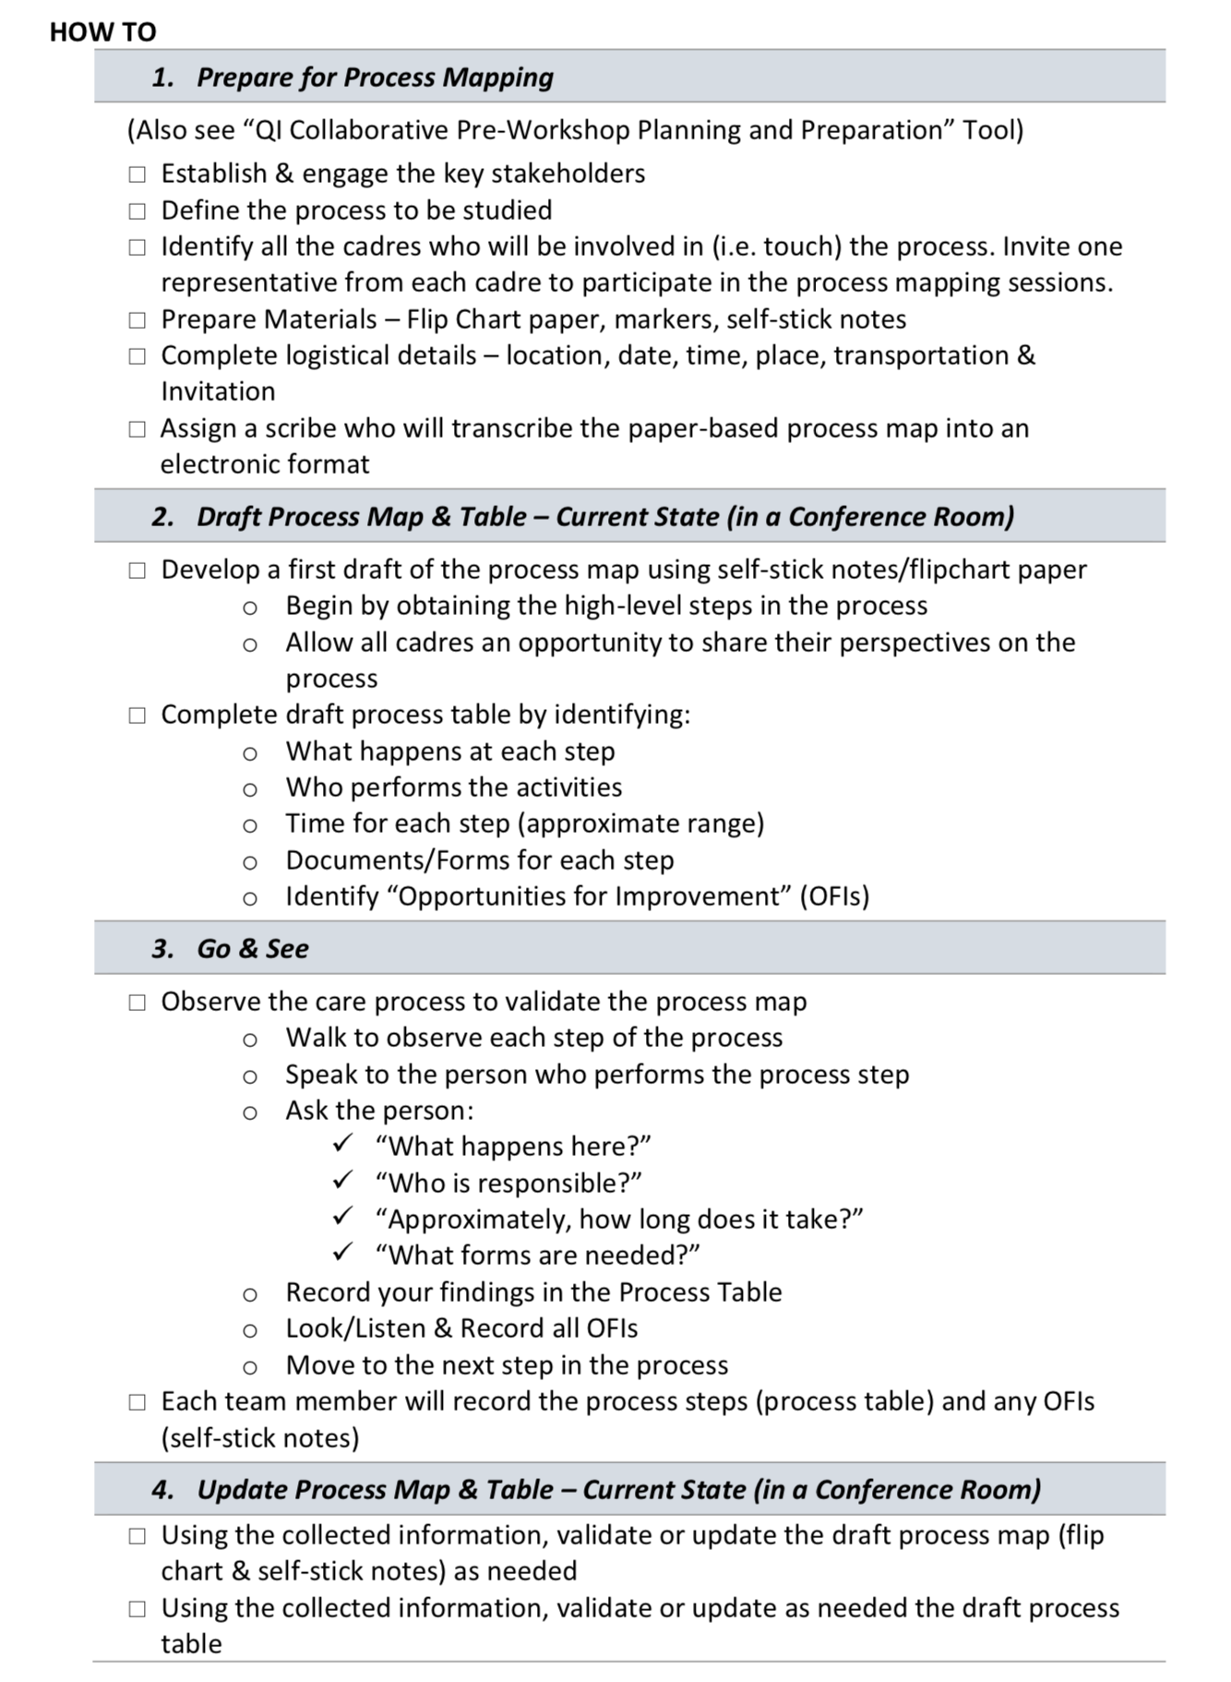
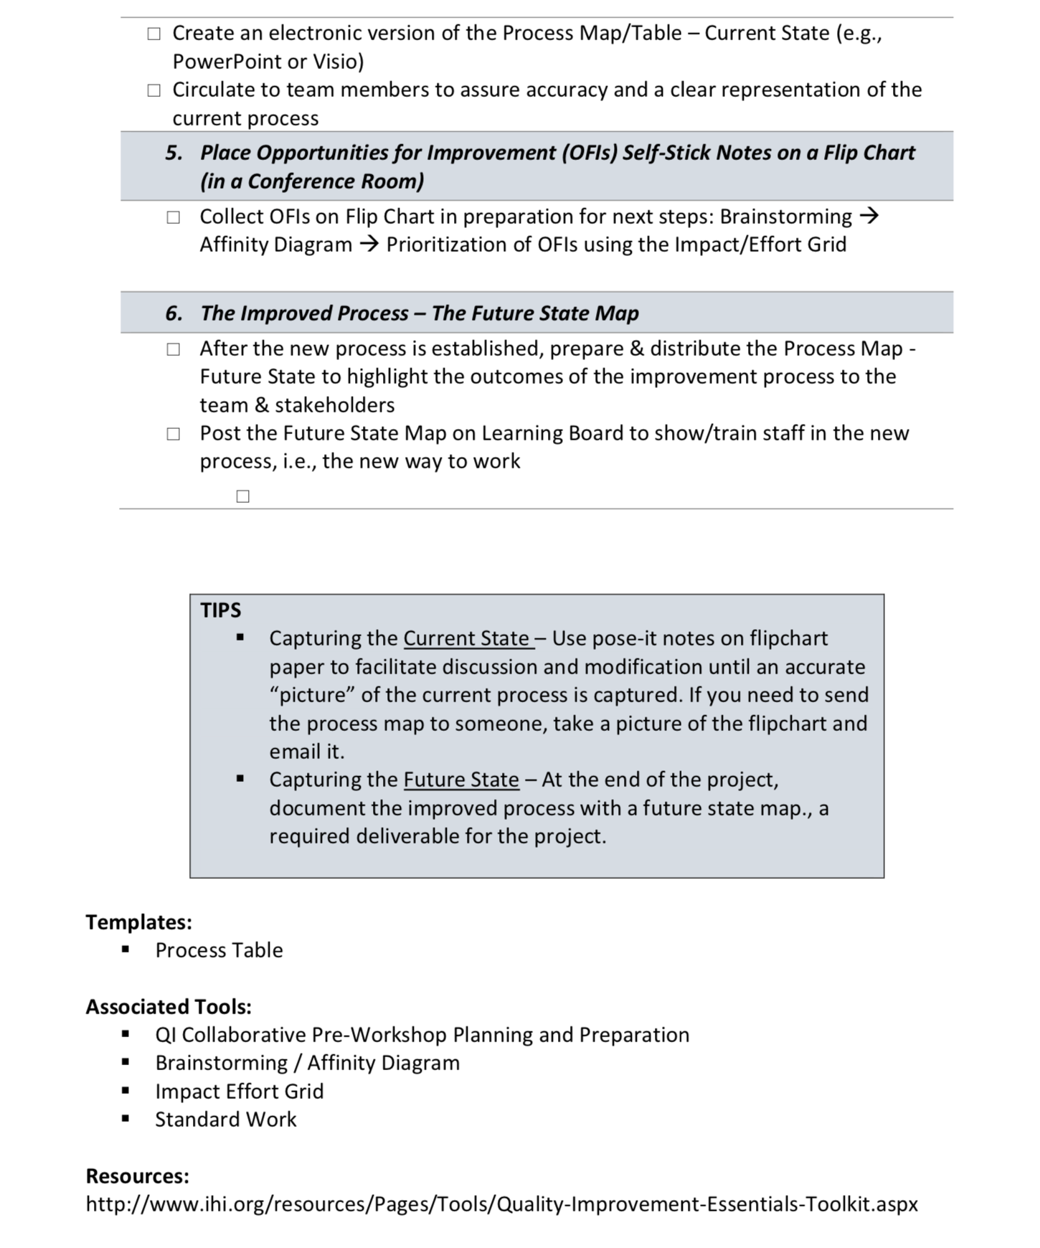
Process Mapping
Workbook, p. 38-41

Slide 25
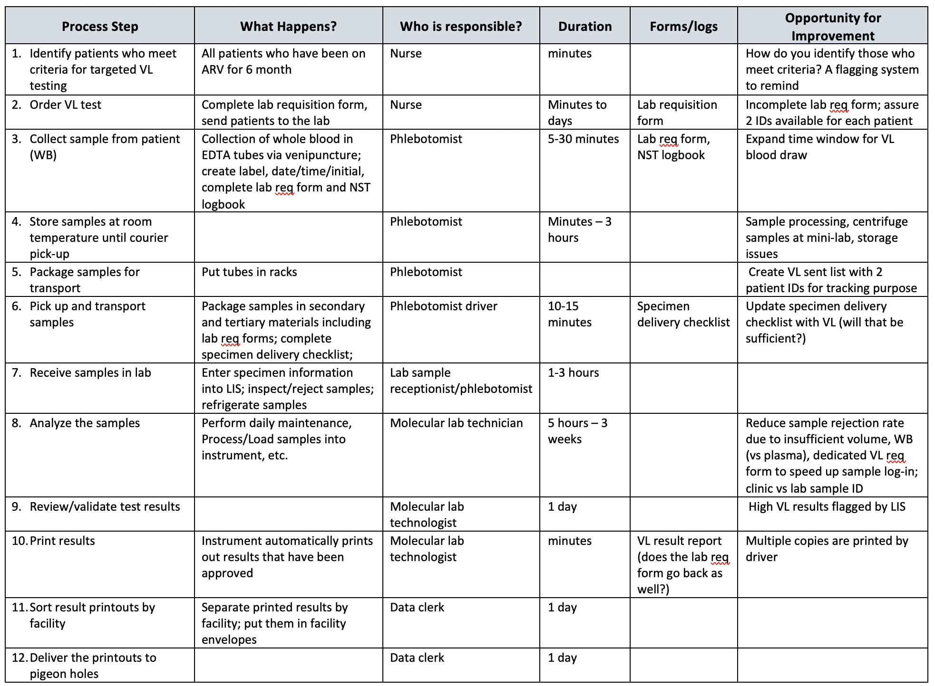
Process Table

Slide 26
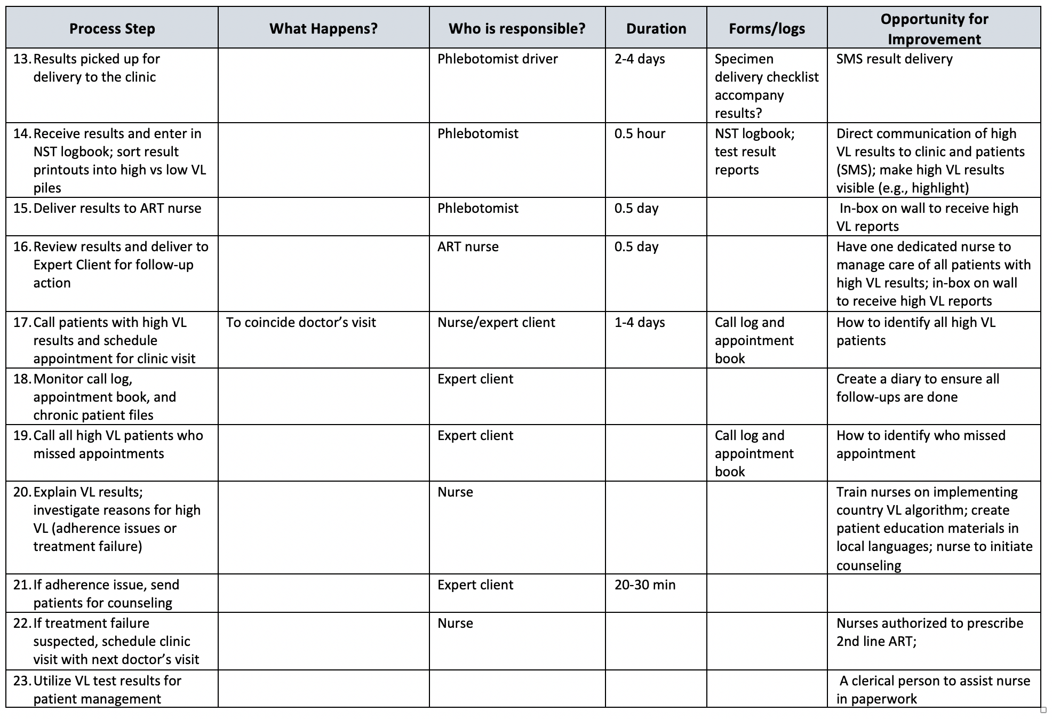

Slide 27
"The first step in any organization is to draw a flow diagram (process map) to show how each component depends on others. Then everyone may understand what their job is. If people do not see the process, they cannot improve it."
W Edwards Deming (1900-1993)

Slide 28
Process Mapping
In order to improve a process, you must first ________ and _____________ the process!
The beginning of any quality improvement journey
SEE
UNDERSTAND

Slide 29
PITFALL #2 Metric Selection
Metric
Pitfalls
Not selecting the appropriate metric for the aim

Slide 30
In God we trust, all others must bring data…
W Edwards Deming

Slide 31
Metrics – Case Studies

Slide 32
ACTIVITY
Review the Aim Statement with your group:
Is it clear? Are the terms defined? Can you measure it? Is the goal realistic?
If not: REWRITE the AIM
Metric: Select the best metric for the project from the multiple choices.
How will you know if any change that you implement is an improvement?
Based on the metric that you selected, design a data collection tool/plan and data display
Debrief with the group
What you will need:
Case Study: Matching the Metric (Measure) with the Aim
Pens
10 MIN

Slide 33
ACTIVITY: Matching the Metric (Measure) with the Aim
Case Study # 1 AIM:
Increase the proportion of ART clients accessing Viral Load Testing (VLT) from 38% to 80% by 30 Aug 2017.
Evaluate the Aim Statement:
Is the aim statement clear? Are the terms defined?
Can you measure it?
If not clear or measurable, then rewrite the aim statement:
Select Metric:
How will you know if any change that you implement is an improvement?
Defend your answers:
Case Study #1
ART Clients & VLT

Slide 34
Access – what is it and how to measure
Access =
Metrics for Access
2nd or 3rd next available appointment
Call Metrics – Answer time, abandonment rate, hold time, calls results in resolution
Customer Satisfaction
Wait times
Capturing copays & insurance verification
Pre-registration rate & registration accuracy

Slide 35
ACTIVITY: Matching the Metric (Measure) with the Aim
Case Study # 2 AIM:
To create VLT access awareness to 80% of Civil Service Organizations (CSOs) within Clinic X’s catchment area by Oct 2016.
Evaluate the Aim Statement:
Is the aim statement clear? Are the terms defined?
Can you measure it? Is there a baseline and goal set?
If not clear or measurable, then rewrite the aim statement
Select Metric:
How will you know if any change that you implement is an improvement?
Defend your answers:
Case Study # 2
Access Awareness for CSOs

Slide 36
ACTIVITY: Matching the Metric (Measure) with the Aim
Case Study # 3 AIM:
To increase on time starts for operating room cases from 23 % to 75% by 30 October 2016.
Evaluate the Aim Statement:
Is the aim statement clear? Are the terms defined? Can you measure it? Is the goal realistic?
If not clear, measurable or realistic, then rewrite the aim statement:
Select Metric:
How will you know if any change that you implement is an improvement?
Defend your answer:
Case Study # 3
On-time starts for the OR

Slide 37
ACTIVITY: Matching the Metric (Measure) with the Aim
Case Study # 4 AIM:
To create VLT access awareness to 100% of clinicians at Clinic X by Oct 2016.
Evaluate the Aim Statement:
Is the aim statement clear? Are the terms defined? Can you measure it? s there a baseline and goal set? Is the goal realistic?
If not clear, measurable or realistic, then rewrite the aim statement:
Select Metric:
How will you know if any change that you implement is an improvement?
Defend your answer:
Case Study # 4
VLT Awareness Clinicians

Slide 38
ACTIVITY: Matching the Metric (Measure) with the Aim
Case Study # 5 AIM:
To have user friendly SOPs/Guidelines available in all consultation rooms by Oct 2016
Evaluate the Aim Statement:
Is the aim statement clear? Are the terms defined?
Can you measure it? s there a baseline measure and goal set? Is the goal realistic?
If not clear, measurable or realistic, then rewrite the aim statement:
Select Metric:
How will you know if any change that you implement is an improvement?
Defend your answer:
Case Study # 5
SOPs

Slide 39
Pitfall #3 Voice of the Customer (VOC)
VOC
Pitfalls
Not connected to the problem
or the intervention

Slide 40
First the Story – VOC Case Study #1
Problem Statement
VOC Asked
Inadequate documentation of EAC sessions for clients with viral load >1000 copies
Staff Supportive or not
Rank clinical services
Clinic wait times
VL results available in file
VL results communicated
High viral load results follow-up
Which questions, if any, directly addresses the problem statement?

Slide 41
First the Story – VOC Case Study #1
Problem Statement
VOC Asked
Inadequate documentation of EAC sessions for clients with viral load >1000 copies
Staff Supportive or not
Rank clinical services
Clinic wait times
VL results available in file
VL results communicated
High viral load results follow-up
Which questions, if any, directly addresses the problem statement?
While this question does address follow-up, it is very non-specific. It would be difficult, given the question’s current form, to gain significant insight into the documentation problem.

Slide 42
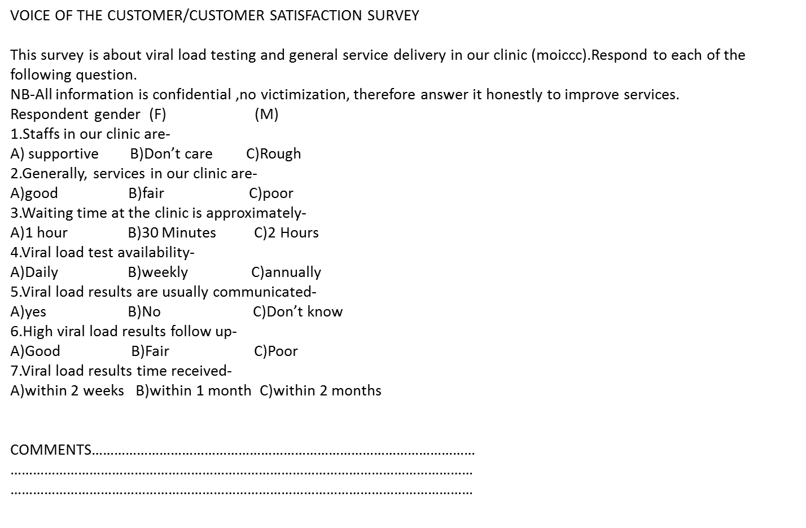
Voice of customer(voc)
Photo of the questionnaire
Our customers were Patients
It was a self administered questionnaire
We administered 4 questionnaires
Lesson Learnt
Majority of the clients were satisfied with the services offered at the facility except for the reason that results are always not available at their appointment time
Write 2 new VOC questions related to your problem statement.
How satisfied are you with the EAC form?
What barriers keep you from documenting the EAC sessions?
Customer = Counselors
Write questions in which you will be able to show improvement with your interventions. Write questions where your post results will be improved.

Slide 43
Knowledge Burst

Slide 44
The secret to improved VOC survey results
Address/link the VOC to the problem statement
In the VOC, ask about things that you intend to “fix” or improve in your intervention
Administer a repeat VOC survey following your intervention
Assess if your intervention satisfied the VOC; i.e., Did your VOC results improve after your intervention?

Slide 45
Case Study #2: VOC Focuses on Problem
Problem Statement = Unsatisfactory Patient Flow / Transfer Process from the Emergency Department to the Inpatient Hospital Medical Units

Slide 46
Voice of Customer Survey - Questions

Slide 47
Case Study: VOC Focuses on Problem
Problem Statement = Unsatisfactory Patient Flow / Transfer Process from the Emergency Department to the Inpatient Hospital Medical Units
Questions asked are directly related to the elements of the patient flow/transfer process:
Satisfaction with transfers
Full Attention to Report
Face-to-face interaction during report
Used Unit to Unit Transfer Tool
Received Information that was needed

Slide 48
The secret to improved VOC survey results
Address/link the VOC to the problem statement
In the VOC, ask about things that you intend to “fix” or improve in your intervention
Administer a repeat VOC survey following your intervention
Assess if your intervention satisfied the VOC; i.e., Did your VOC results improve after your intervention?
VOC Summary

Slide 49
PITFALL #4 PDSA
PDCA
Pitfall
Not One and Done
Testing Too Multiple Changes in One PDSA
Not Small Tests of Change

Slide 51
Knowledge Burst

Slide 52
PDSA - Description

Slide 53
A Published Paper on PDSA
73 Published Studies reviewed in this article

Slide 54
PDSA – 5 Key Features
FEATURE OF PDSA | DESCRIPTION OF FEATURE | HOW TO MEASURE THE FEATURE
Iterative cycles | Iterative learning & improvement - Learning from one cycle linking and informing the next cycle | How many cycles? Cycles linked to each other?
Prediction-based testing of change | Make prediction in the plan stage; Change tested in the do cycle and compared with prediction in the study stage | Prediction made?
Small-scale testing | Start small in scale & build in scale as confidence grows | Sample size per cycle? Temporal duration of cycles? Number of changes tested per cycle? Did sequential cycles increase scale of testing?
Use of data over time | Regular data = 3 or more data points with consistent time intervals Time frame = at monthly or more frequent intervals | Was data collected over time?
Documentation | To support local learning & transferability of learning to other settings | Was the PDSA documented so others could implement or scale up the change?
Taylor MJ, et al. BMJ Qual Saf 2013;0:1–9. doi:10.1136/bmjqs-2013-001862

Slide 55
A Published Paper on PDSA
Of 73 Published Studies reviewed, only 2 studies included all 5 key features of PDSA
Notes:
Take home message –
#1 - PDSA seems simple to do; however, commonly, even in articles published in scientific journals, PDSA is neither implemented well nor implemented faithfully to the model
#2 – You can always improve your own PDSA cycles – making your PDSA cycles improve with each cycle. Always seek to learn and improve your PDSAs based on the 5 key elements.

Slide 56
Selecting the change: How to determine what changes to test
CHANGE
Have a
Clear Aim
Understand Root Cause
Research
(Evidence-based changes)
Brainstorm
Experience
Listen to Voice of Customer
Notes:
- How to determine what test of changes to do
- First have a clear Aim, which means the team knows what to work towards
- Reflect on the major factors or drivers that will influence achieving the goal. This helps to focus the group’s efforts and decreases the likelihood that unnecessary work will occur
- Determining the major factors or drivers helps to limit the interventions or actions to the few that are most likely to help achieve the goal.

Slide 57
Define
Measure
Analyze
Improve
Control
STUDY
Qualitative feedback from Grace
“Would be nice to have check boxes for common reasons that clients don’t take medications.”
“Date column is too small to write date”
ACT-4 | PLAN -1
Asses the impact of the intervention and determine its adoptability and utilization for ensuring complete documentation of EAC sessions | Develop EAC tool for documenting the sessions Train the clinicians on the new tool Start documenting the EAC sessions
STUDY-3 | DO-2
Determine the % of client files with complete documentation of the 3 EAC sessions | Develop the EAC tool Train the clinicians of the EAC tool Document the EAC sessions
PDSA #2
Write the second small test of change / PDSA for this project.
ACT
Adapt
Redesign Form #A based on Grace’s feedback
How many changes can be tested in one iteration / 1 PDSA Cycle?
PLAN
Test EAC Form #A
1 Day (Tuesday) with 1 Nurse (Grace) in 1 Clinic (MCH Clinic) with 1 Patient
Prediction: The tool will be easy to use, capture all the required information, engage patient
DO
Test on Tuesday as designed
PDSA #1
Write the first small test of change / PDSA for this project?
57
Notes:
57
57
Here is a chance to gain participation & ask interactive questions. The animation leads through the questions (in blue boxes). Stop after box #2 and ask the audience what would be a small test of change. Only move to the yellow boxes (#3-7) – answers – when you have engaged the participants in attempting to identify a small test of change.

Slide 58
plan
Do
Study
Act
Control
How many cycles of the one PDSA (EAC Form) would you carry out?
Baseline (n)19; 70%
Oct (n)25; 93%
Nov (n)26; 96%
Dec (n) 26;96%
What about concurrent PDSAs?
A PDSA around notifying patients?
A PDSA around process changes for documentation?
PDSA 1
Notes:
Question #1 – One PDSA is very, very, very rarely enough
Question #2 – Generally, we like to test one change at a time – to be able to fully assess one change without confounding it by testing more than one change at a time. However, if the two processes are separate, you could speed up the QI project timeline by testing concurrent PDSAs. In this case, you could work on your patient notification process and your EAC form PDSAs concurrently - at the same time. This would be best after the team has some PDSA practice and enough people on the team to be able to be working on 2 PDSAs at a time.

Slide 59
Seeing the Big Picture
How to assess patient care in a clinic site

Slide 60
Story: Patient A ”Falls through the Cracks”
VL Ordered
VL Results reported
Appointments- No results mentioned
Appointment / VL results noted; Submit request for 2nd line Tx
Committee denies request to switch to 2nd line Tx
Next Appointment/ 2nd VL?
27 MAR
7 MAY
17 JUN
19 AUG
5 JUN
8 JUL
20 JUL
7 MAY 2015
5 JUN 2016
VL = 31,970
ID as High Viral Load
1 Year to Identify High Viral Load

Slide 61
Trace the patient

Slide 62
Viral Load recorded in patient’s chart, but no action taken for 2 visits

Slide 63
Learning Burst

Slide 64
What is this project about?
“Viral load suppression for patients”
Mapopa Kenneth Kapira, HDA

Slide 65
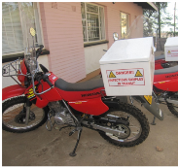
The Viral Load Cascade
Demand Creation for Testing
Specimen Collection & Processing
Sample Transport
Laboratory Testing
Result Reporting & Interpretation by Clinician
Patient Management

Slide 66
How do we truly understand the outcome of our viral load cascade process?

Slide 67
Assessing our patient care
Look at the evidence
Look at the care provided
Look at the care documented

Slide 68
Country Algorithm Does the care provided follow the country algorithm?

Slide 69
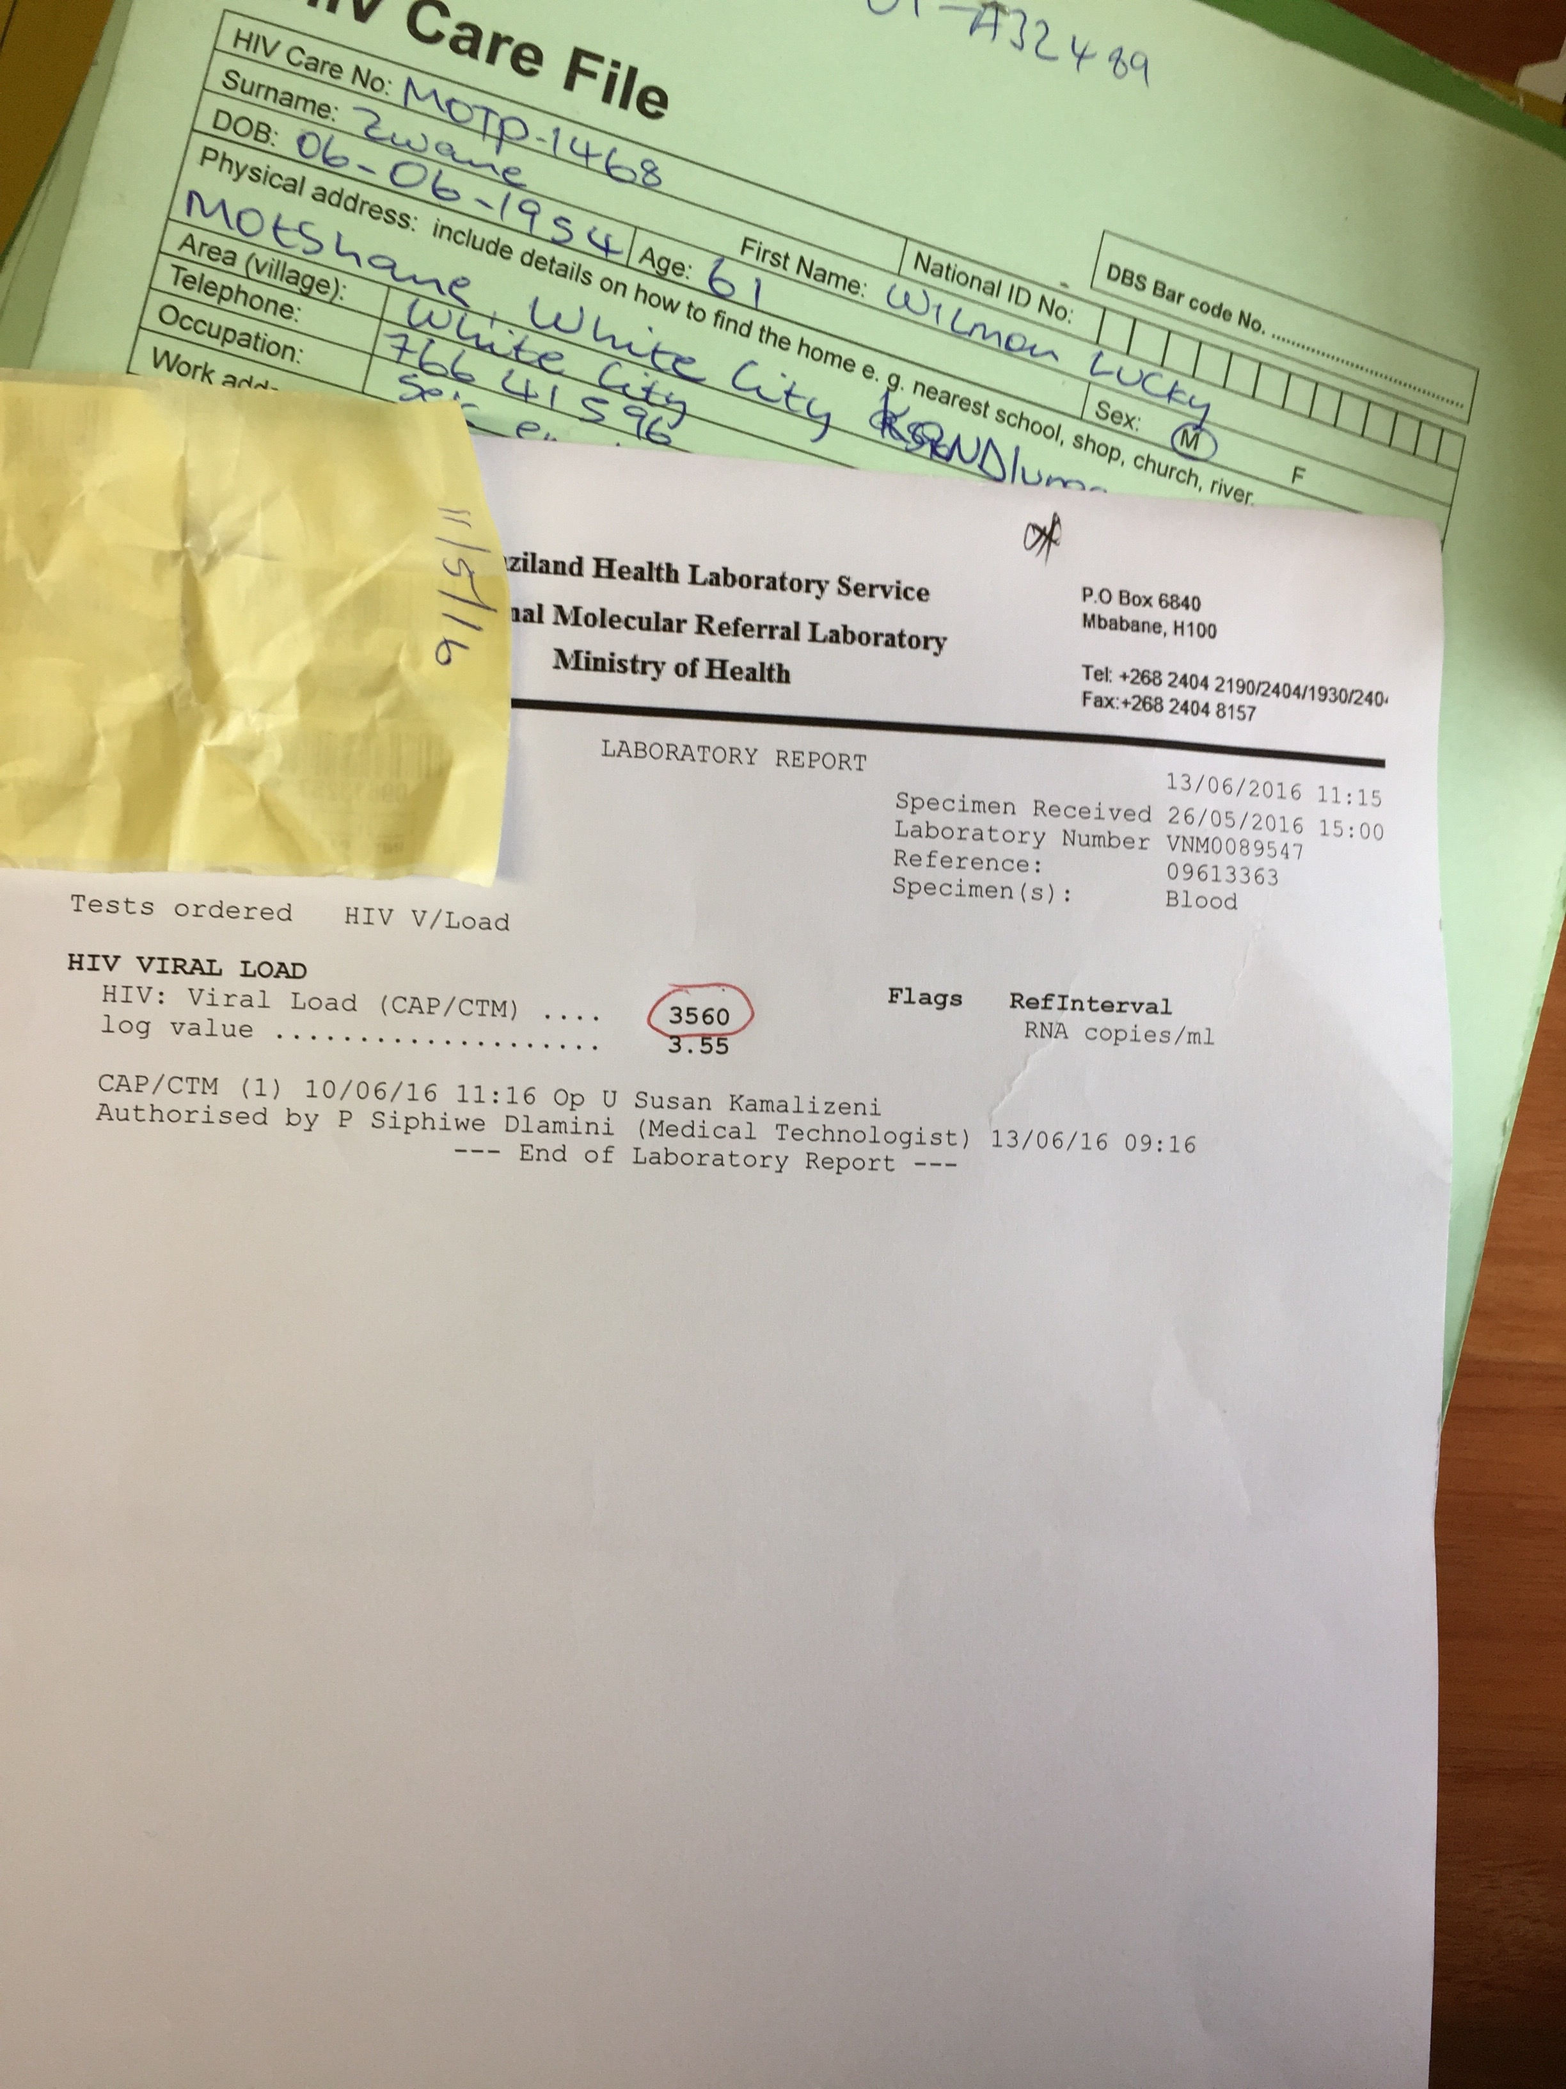
Viral Load Results 10 March 2016
223,888

Slide 70
Chart Review Template Viral Load Cascade – Result Reporting & Patient Management
Patient # | VL #1 Ordered / Drawn Date | Date VL Returned to Chart | Date VL Noted by Clinician / Action | IAC (or EAC) #1 | IAC (or EAC) #2 | IAC (or EAC) #3 | VL #2 Ordered / Drawn Date | Is VL Suppressed?? / Action

Slide 71
Patient Tracing / Chart Review 4/5 patients did not have High VL follow up per country algorithm
Patient | VL Result / Date Validated | Clinic Visits / Adherence% / Drug Supply | IAC | VL #2
A | 1,653 copies 17 Aug 2015 |  |  | 5 Jan 2017 No Result
B | 223,888 copies 10 Mar 2016 (C) 9 May 2016 (V) | 16 Jun 2016 / 93% / 3 mo. 29 Sep 2016 / 85% / 3 mo. 29 Dec 2016 / 101% / 3 mo. | IAC #1 – 23 Mar 2017
C | 6,588 copies 2 Nov 2016 |  |  | 5 Jan 2017 No Result
D | 82,201 copies 4 Nov 2016 |  | IAC #1 - 25 Jan 2017 IAC #2 – 15 Feb 2017 IAC #3 – 15 Mar 2017 | Drawn 12 April 2017
E | 17,863 copies 28 Feb 2017 | 16 Feb 2017 / 96% / 3 mo.
C = Sample Collected, V = Sample Validated by Laboratory

Slide 72
Today’s Topics – 5 Top Pitfalls
5 Pitfalls to Avoid
What to do differently next time
LEARN FROM
Process Mapping → Not connecting the process map to the project
Metric Selection - Not selecting the appropriate metric for the aim
Voice of the Customer – Not connected to the problem or the intervention
PDSAs – Only One and Done, Testing Multiple Changes in one PDSA, Not small tests of change
Outcome Focus – Forgetting the big picture, i.e., Patient Care

Slide 73
PITFALLS If you fall into a pit, I hope you learned something
Lessons
From the Pit

Slide 74
Thank you
Quality Improvement is not about Perfection, but it is about Learning

